Slide 1
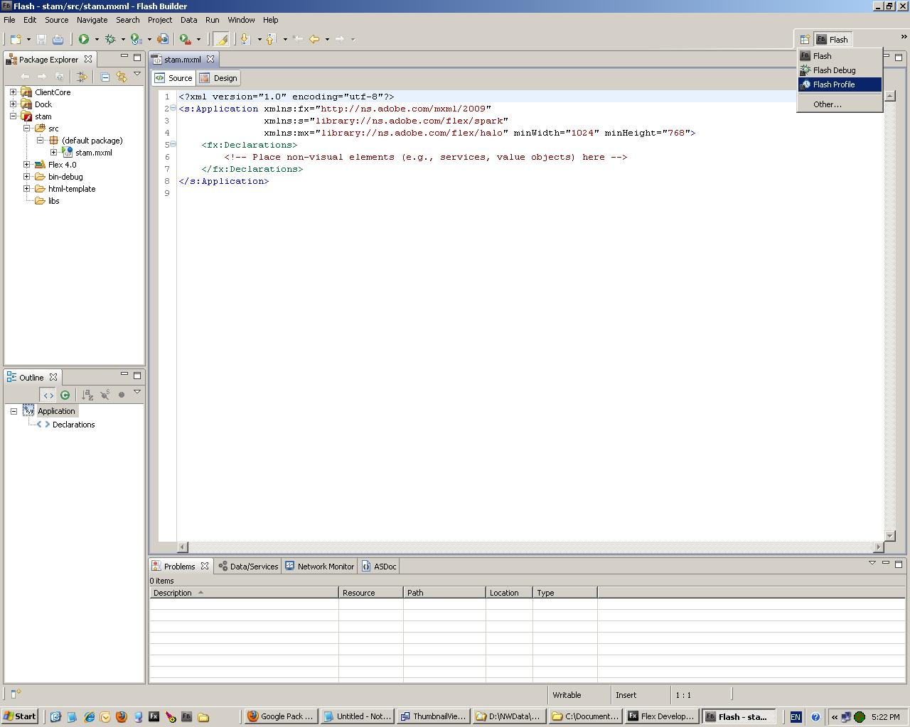
Select The Profiler Perspective

Slide 2
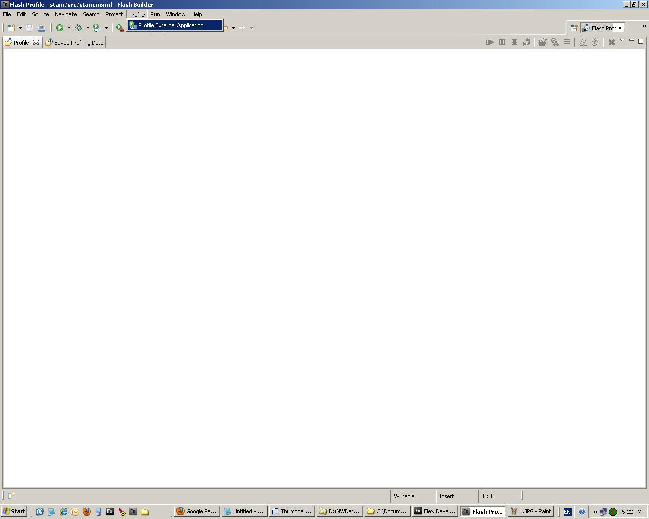
This option is only available from the profiler workspace

Slide 3
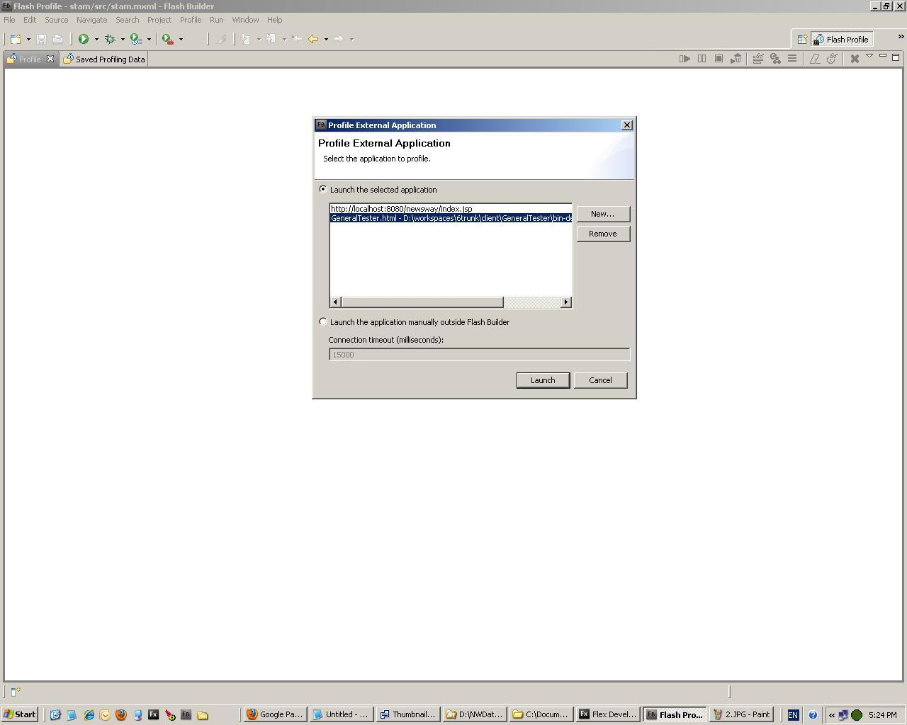
Choose a location for the HTML wrapper of the application

Slide 4
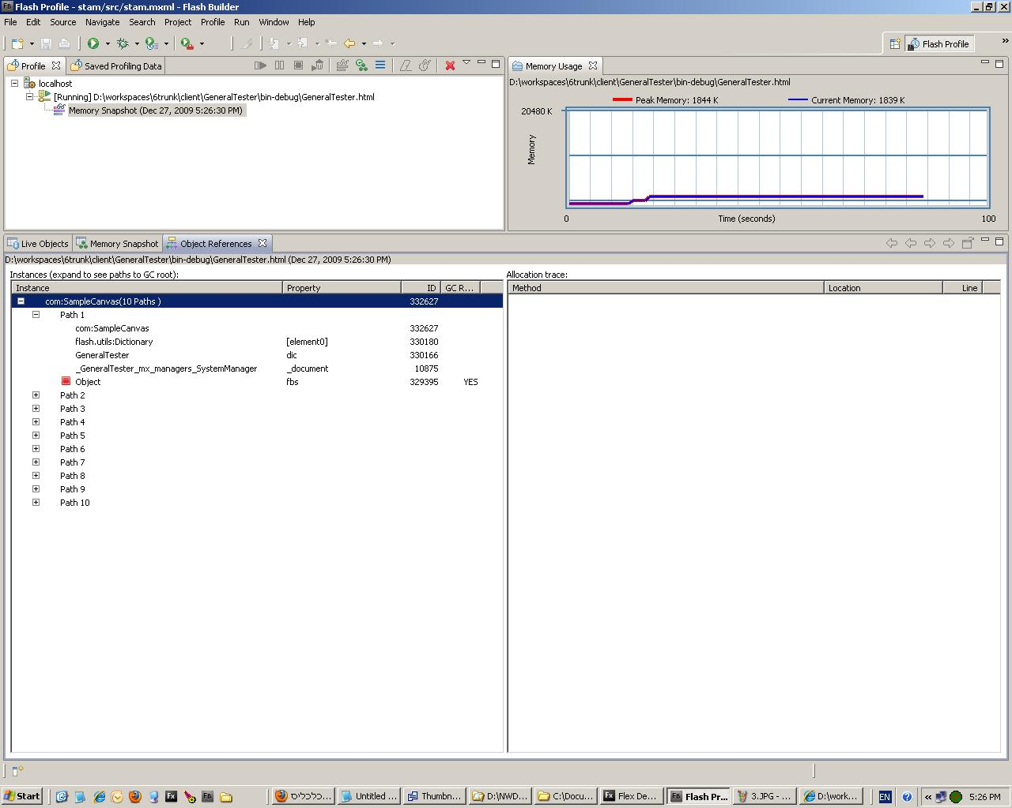
If you see a “YES” in the GC root, it means that you might have a potential memory leak.
Hierarchical order of parent objects.
This tells you who holds up your object from being garbage collected, who holds up the parent and so on..

